Slide 1



GenuineEye: RealFake Classifer
Group Members:
Atharva Jaiswal (229309131), Khushi Bansal (229309142), Lakshay Mehta (229309175), Yashashvi Sarran (229309119)

Slide 2
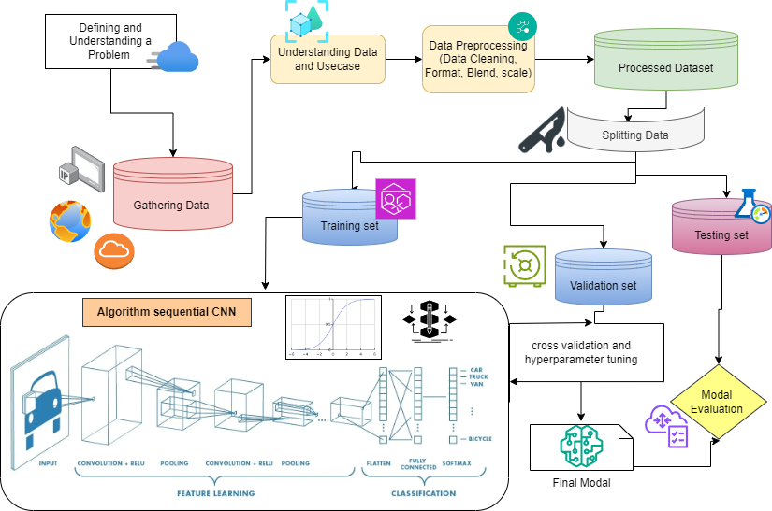
Project Flow

Slide 3

Roles and Responsibilities
Yashashvi Sarran (229309119) : Gathering Data
Khushi Bansal (229309142): Preprocessing Data
Atharva Jaiswal (229309131): Model Development & Hypertuning
Lakshay Mehta (229309175): Performence Evaluation

Slide 4



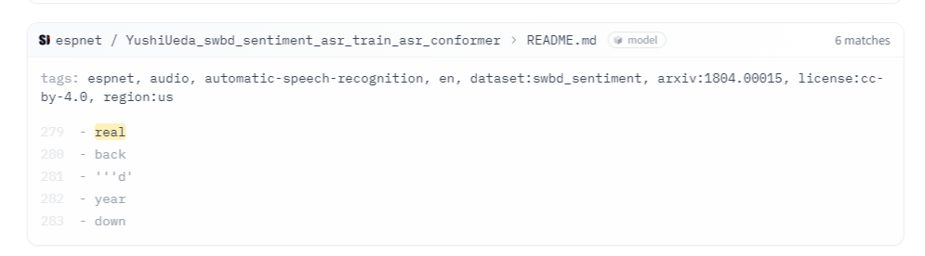

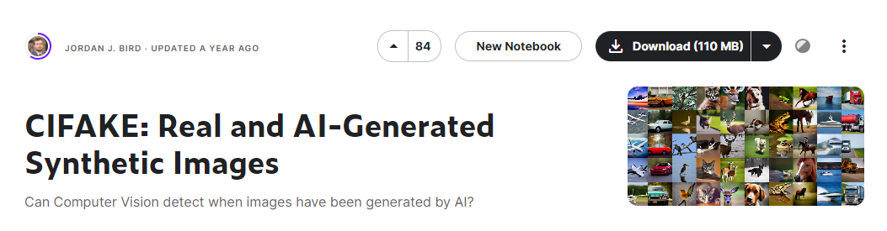
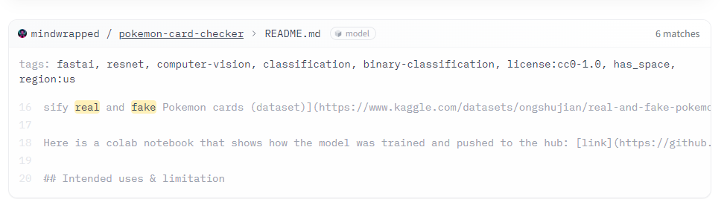


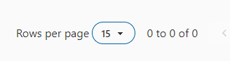
Gathering Data

Slide 5
Choosing from Potential Dataset
Advantages: High Resolution Images Disadvantages: Not enough Images,
Advantages: Image abundance, formatted Disadvantages: Low resolution

Slide 6
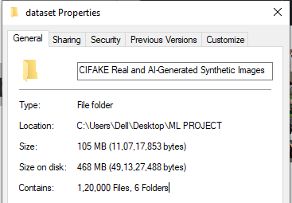
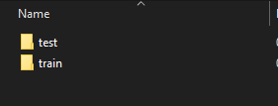
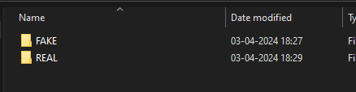
Final Choice

Slide 7
Final Choice
We selected this dataset due to its substantial volume of data, a crucial factor for optimizing the performance of neural networks. With a vast collection comprising a total of 1,20,000 images, this dataset offers an abundance of samples for training, validation, and testing processes. The sheer scale of the dataset provides ample opportunities for the neural network to learn diverse patterns and features, thus enhancing its ability to generalize effectively to unseen data. Additionally, the ample quantity of images enables robust training procedures, helping to mitigate issues such as overfitting and improving the network's overall performance and robustness.

Slide 8
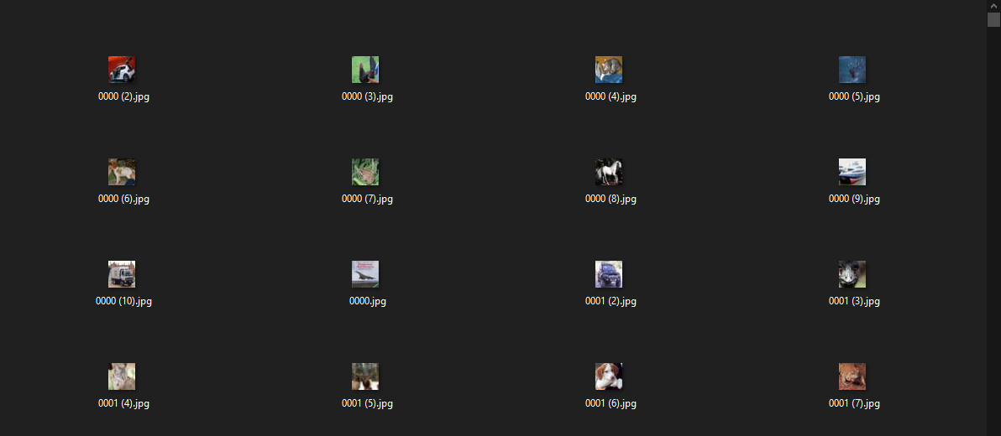
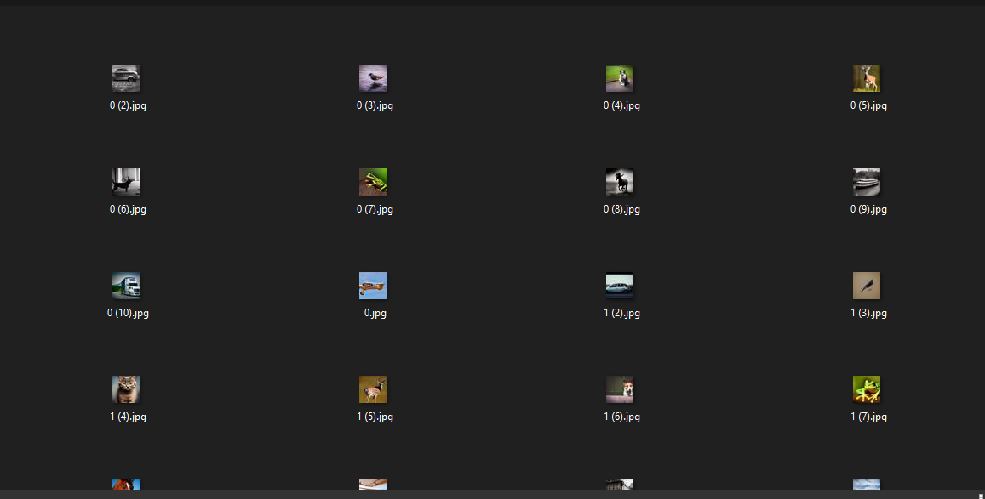
The Dataset
Real
Fake

Slide 9

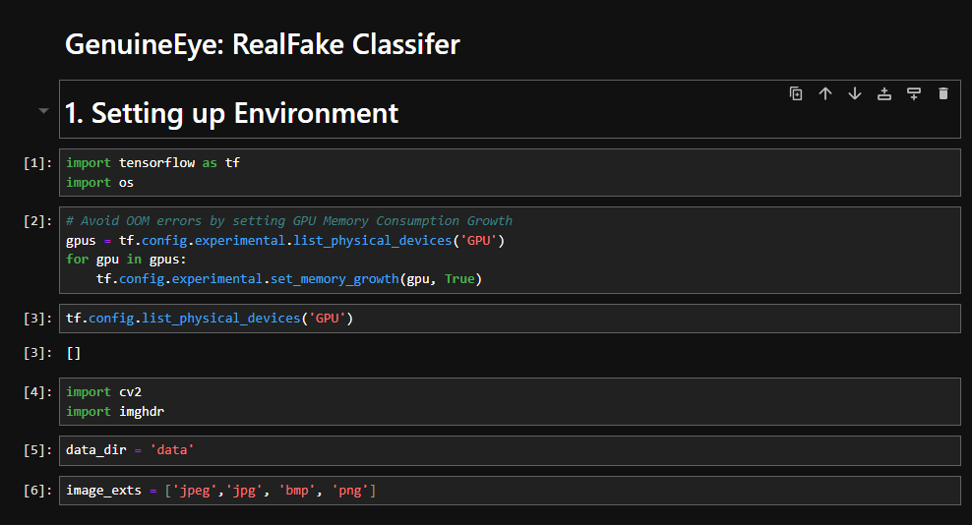


Setting up Environment
We import TensorFlow for neural network tasks and the 'os' library for directory navigation in the image dataset.
To mitigate the risk of encountering an OutOfMemoryError,
we implement memory constraints and configure the GPU settings.
We utilize OpenCV (cv2) for advanced image processing and computer vision tasks, while leveraging the Imghdr library to accurately read image files of various extensions.
Loading Libraries
Creating list of extension of images in our dataset

Slide 10
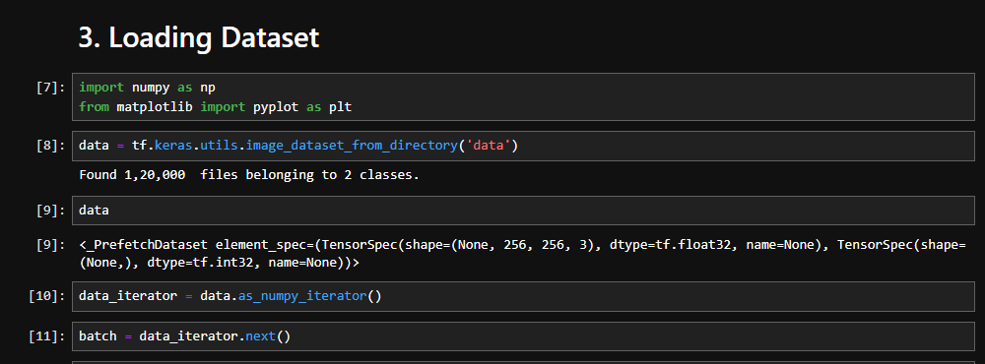
Numpy for numeric computation and matrix algebra
Matplotlib for plotting images
Loading Libraries

Slide 11
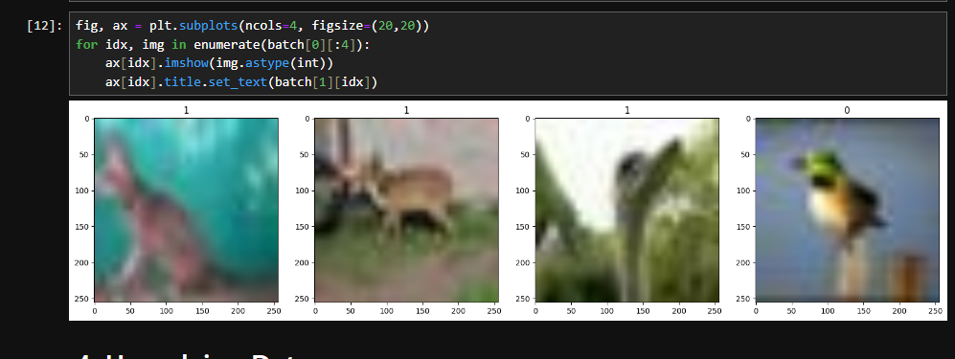
Viewing some images and using Matplotlib to check if the data is loaded correctly

Slide 12
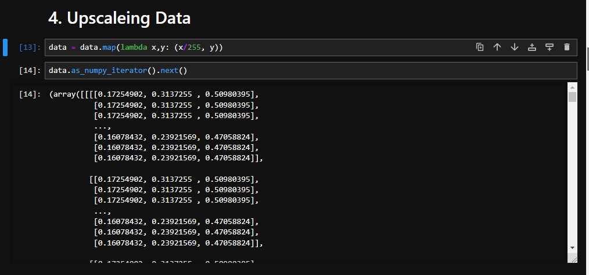
The primary preprocessing step involves upscaling the images to enhance their resolution. Utilizing techniques such as Principal Component Analysis (PCA) or other dimensionality reduction methods isn't feasible due to the inherent low resolution of the data. Applying such techniques would result in significant data loss, ultimately leading to degraded performance of the model.

Slide 13
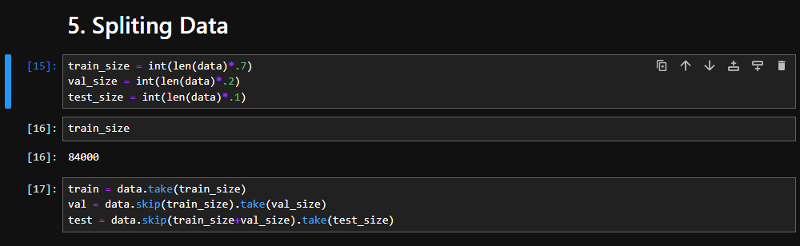
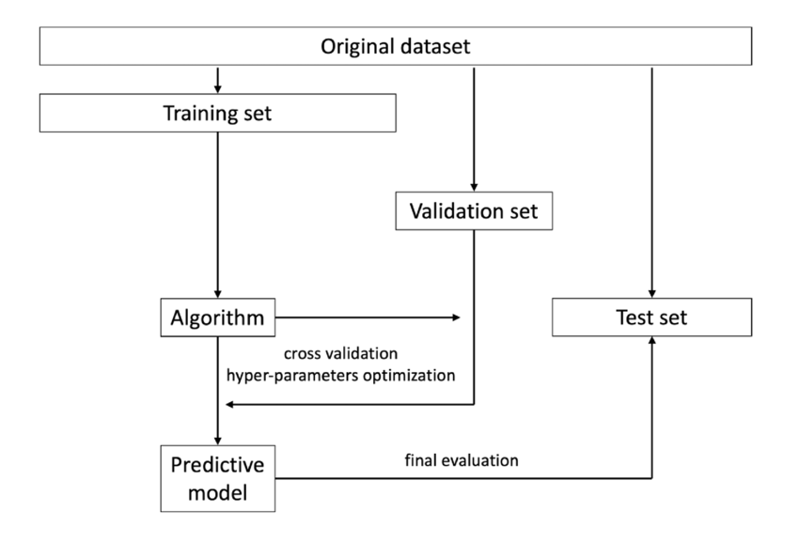
Splitting Data into training, validation and test sets.
Training Set(70% of data): Largest subset for model training, learning patterns and optimizing parameters.
Validation Set (20% of data): Used for tuning hyperparameters and preventing overfitting.
Test Set (10% of data): : Evaluates model performance on unseen data, gauging generalization ability.

Slide 14
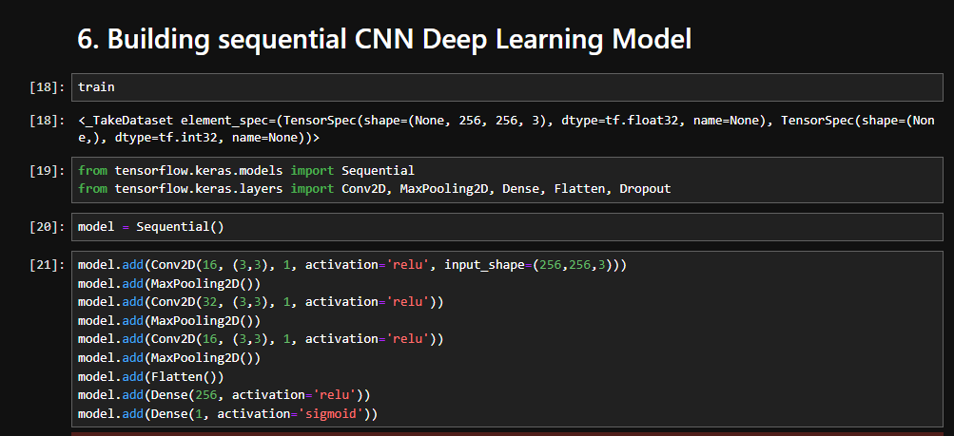

Slide 15
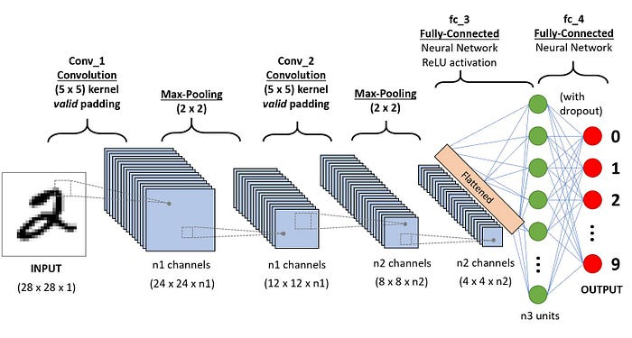
What this modal is doing(Sequential CNN Working)
filters

Slide 16
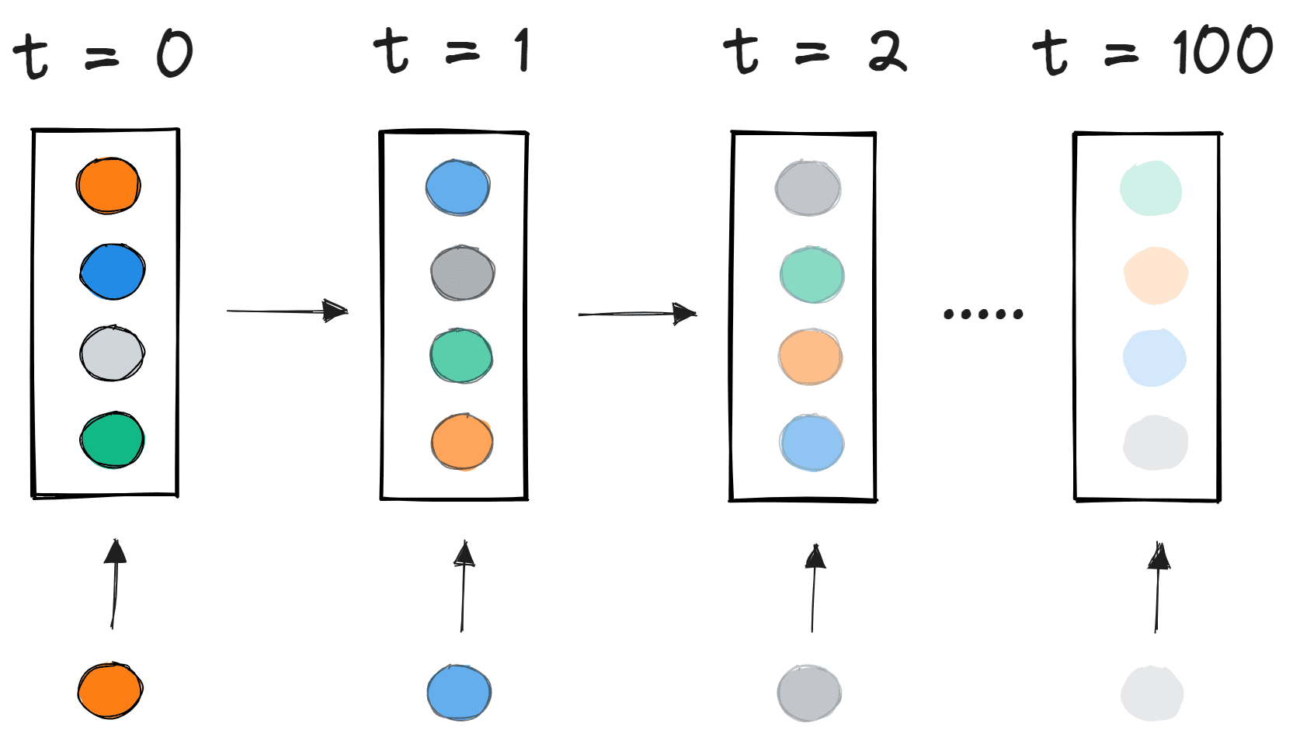
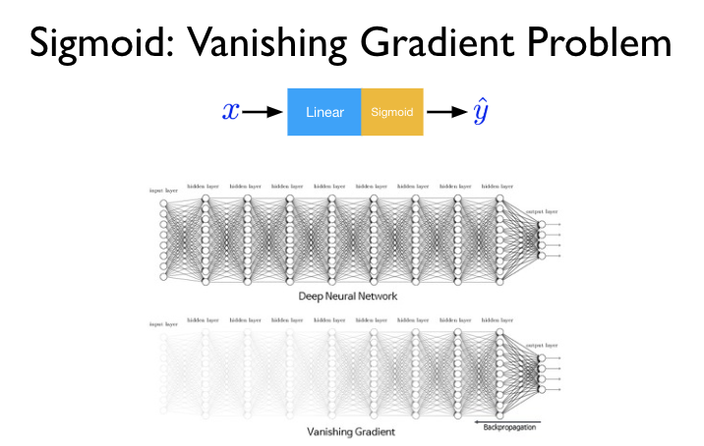
Vanishing gradient problem
The gradients of the early layers—those that are closest to the input layer—are obtained by multiplying the gradients of the later layers—those that are near the output layer—during the backpropagation process, which results in the vanishing gradient problem.

Slide 17
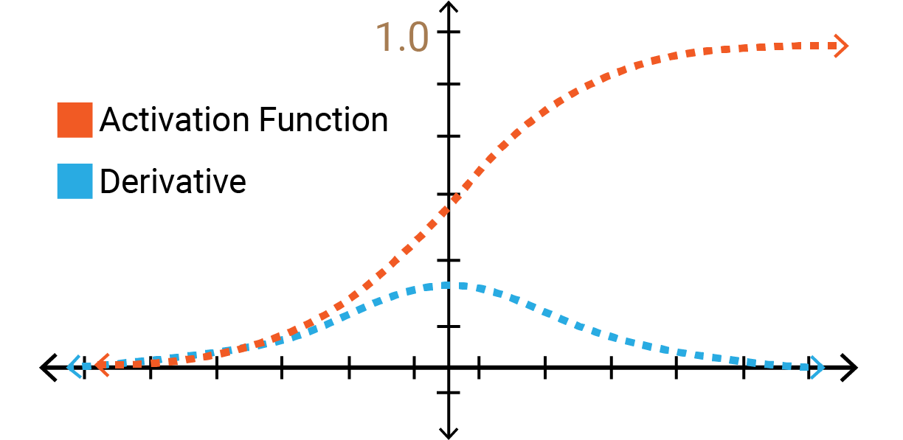
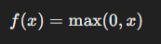
Relu Activation
ReLU (Rectified Linear Unit) activation is non-linear activation function used for neural networks to make this model non-linear. It introduces non linearity if its positive and zero otherwise, It helps vanishing gradient problem.

Slide 18
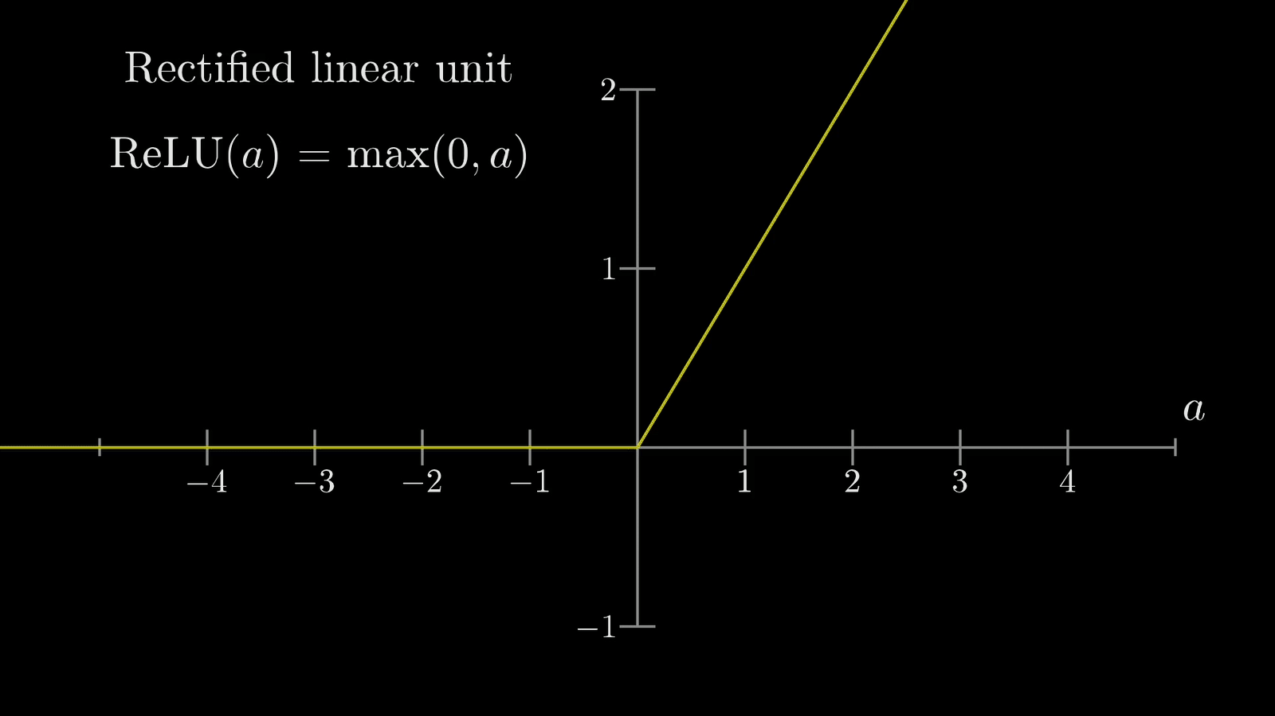

Slide 19
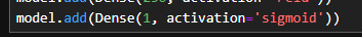
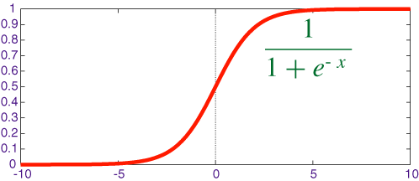
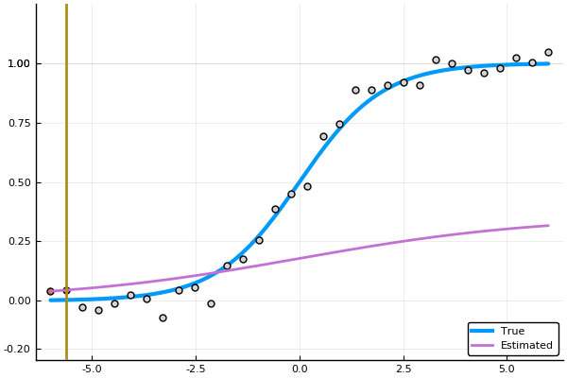
Sigmoid
When the activation
function for a neuron is a sigmoid
function it is a guarantee that
the output of this unit will always be between 0 and 1

Slide 20

Fake
Fake
Real

Slide 21
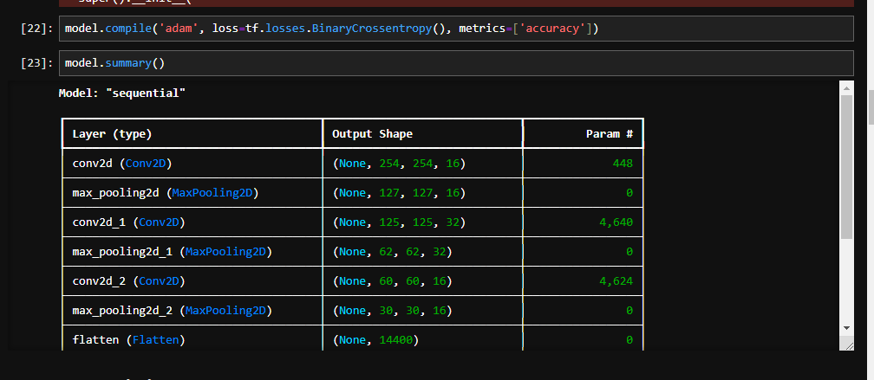
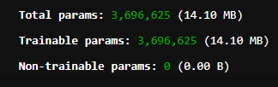
Optimizer function
Metrics accuracy during training why accuracy?..because its classification task
Total params

Slide 22
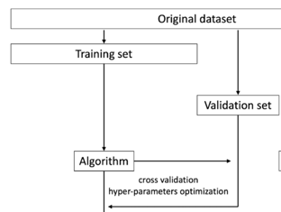
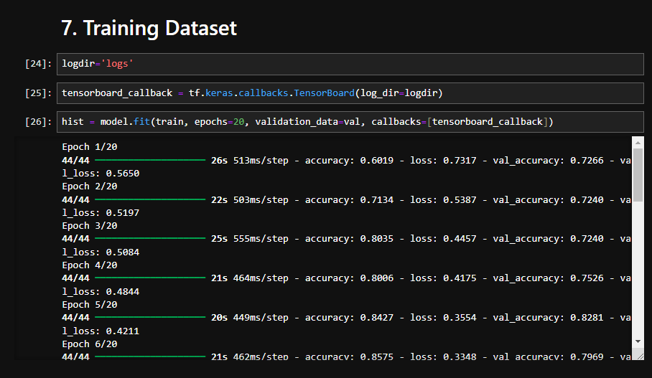
Training Dataset and hyper tuning
Making a tensor board to log the training process and make evaluations later
Hyper tuning from validation set
Epochs refer to the number of times the entire dataset is passed forward and backward through the neural network during training.

Slide 23
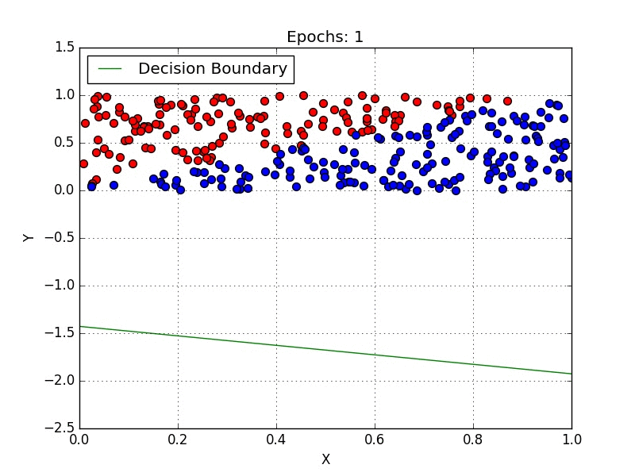
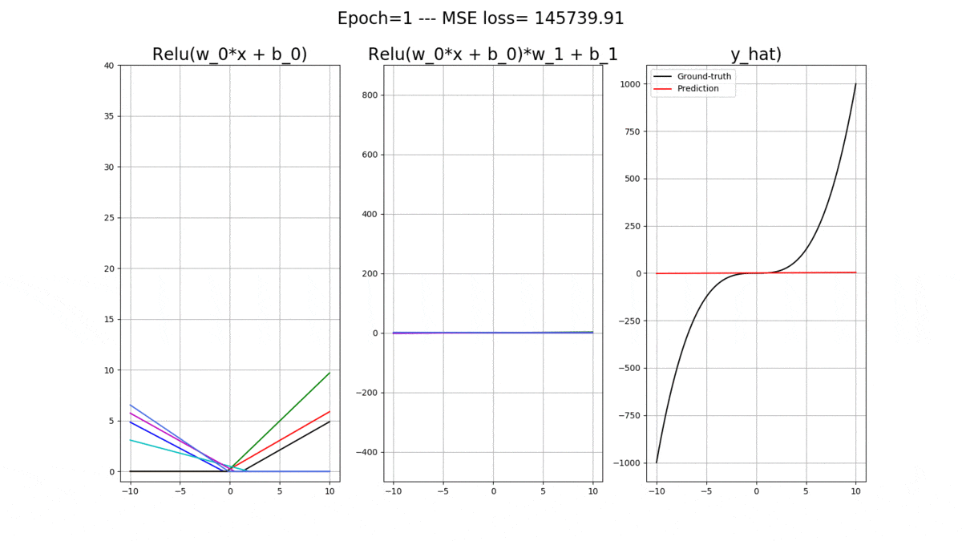
A visulisation how training works according to epochs

Slide 24
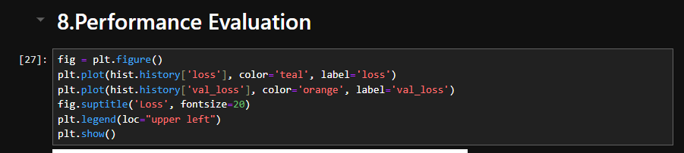
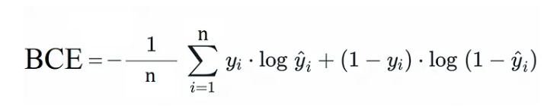
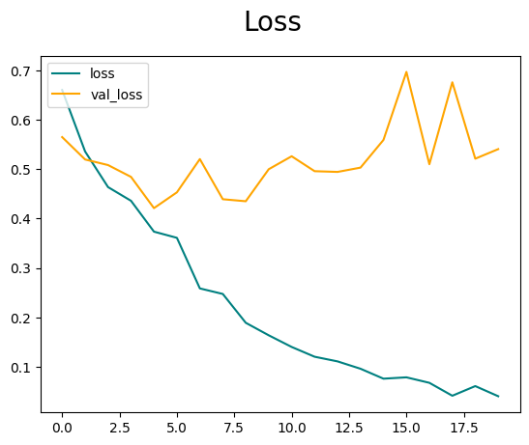
LOGG-LOSS VISULISATION
Binary Cross-entropy
A neural network that performs binary classification—that is, predicts one out of two classes—calculates its loss using the binary cross-entropy loss function, also known as log loss.
Loss measures how well the model fits the training data, while validation loss assesses its performance on unseen validation data, aiding in detecting overfitting.

Slide 25
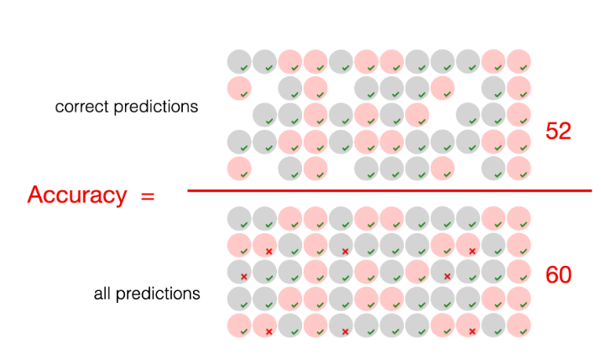
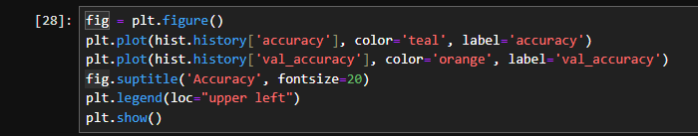
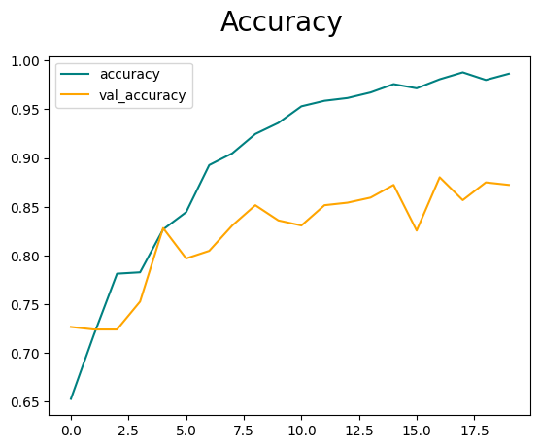
Accuracy Training Visualization
This is plotting the training accuracy and validation accuracy curves during the training of a neural network model. It visualizes how well the model is learning and generalizing to unseen data in terms of classification accuracy.
1. Accuracy: It measures the proportion of correctly classified examples out of the total number of examples in the training dataset. It's a common metric for evaluating classification models.
2. Validation Accuracy: Similar to accuracy, but computed on a separate validation dataset that the model hasn't seen during training. It assesses how well the model generalizes to new, unseen data, helping to gauge its performance beyond the training set.

Slide 26
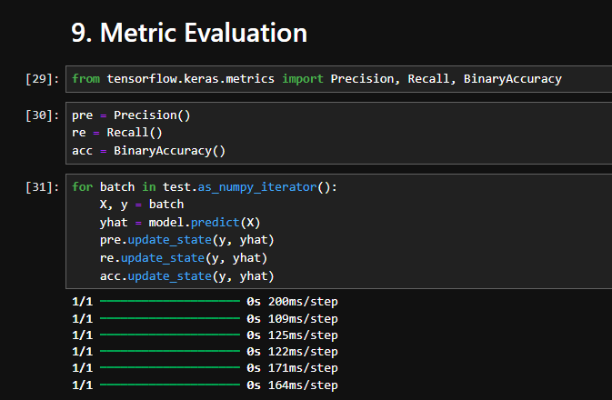
This code calculates precision, recall, and binary accuracy metrics for a trained model on a test dataset in TensorFlow. Here's why it's important:
1. Performance Evaluation: It provides insights into the model's performance beyond accuracy by assessing precision (the proportion of true positives out of all predicted positives) and recall (the proportion of true positives out of all actual positives).
2. Understanding Model Behavior: Precision and recall offer a more nuanced understanding of the model's behavior, particularly in imbalanced datasets where accuracy alone might be misleading.
3. Model Tuning: These metrics help in fine-tuning the model and understanding its strengths and weaknesses, guiding adjustments to improve overall performance.
4. Decision Making: Precision and recall are crucial in decision-making scenarios where different costs are associated with false positives and false negatives, such as in medical diagnosis or fraud detection.
5. Validation: Evaluating the model on a separate test dataset ensures that the reported metrics are indicative of its performance on unseen data, enhancing its reliability in real-world applications.
Accuracy shows how often a classification ML model is correct overall.
Precision shows how often an ML model is correct when predicting the target class.
Recall shows whether an ML model can find all objects of the target class.

Slide 27
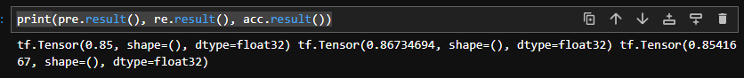


Results
Accuracy shows how often a classification ML model is correct overall.
Precision shows how often an ML model is correct when predicting the target class.
Recall shows whether an ML model can find all objects of the target class.
Precision : 85%
Recall: 86.73%
Accuracy: 85.41%

Slide 28

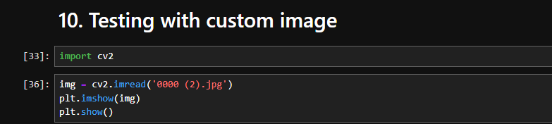
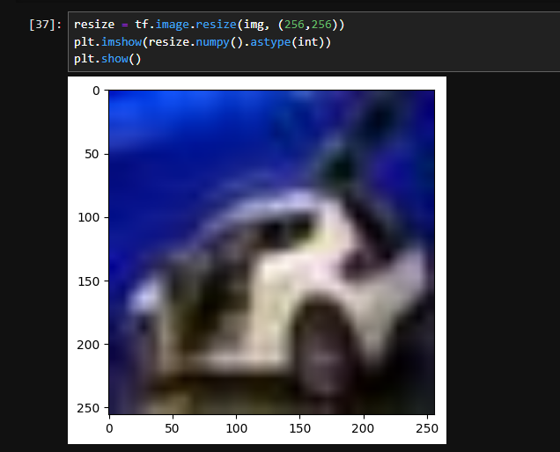
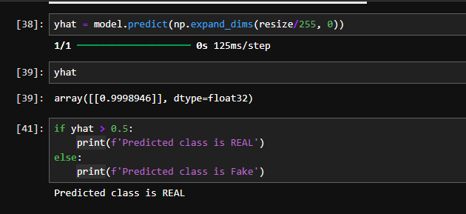
Predicted class is REAL

Slide 29
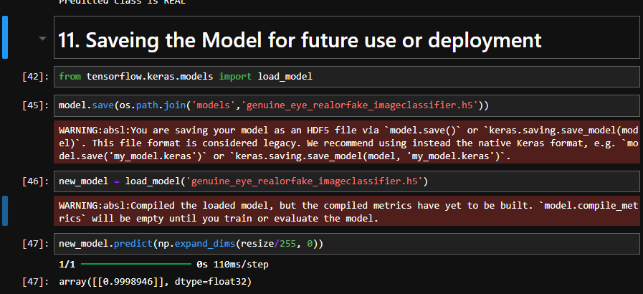


Slide 30


Slide 31
References
https://www.evidentlyai.com/classification-metrics/accuracy-precision-recall#:~:text=Accuracy%20is%20a%20metric%20that,often%20the%20model%20is%20right%3F
https://medium.com/artificialis/neural-network-basics-loss-and-cost-functions-9d089e9de5f8
https://www.analyticsvidhya.com/blog/2022/06/understanding-loss-function-in-deep-learning/#:~:text=The%20loss%20function%20for%20this,the%20performance%20of%20regression%20models.

